Slide 1
Lesson 02.00 - Mixed Data
How do we define data with multiple parts?

Slide 2
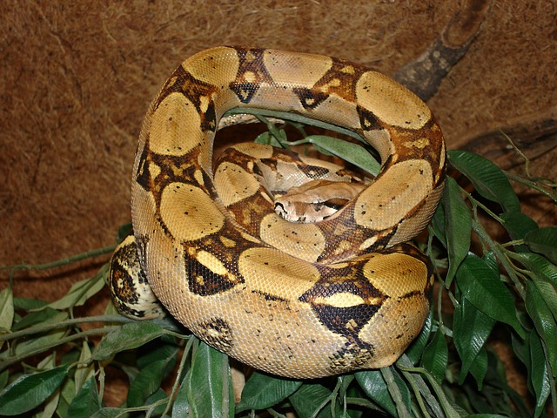
a boa is a boa(string, number, string)
data Boa:
| boa(name :: String, length :: Number, eats :: String)
end

Slide 3
a boa is a boa(string, number, string)
data Boa:
| boa(name :: String, length :: Number, eats :: String)
end
B1 = boa("Slinky", 30, "pets")
B2 = boa("Slim", 50, "homework")

Slide 4
data defintions also create functions
# boa : string number string -> boa
# aboa.name : boa -> string
# aboa.length : boa -> number
# aboa.eats: boa -> string
# is-boa: boa -> boolean

Slide 5
write 3 examples of boa-fit-cage
fun boa-fit-cage(aboa :: Boa, limit :: Number) -> Boolean:
doc: “consumes a boa and a limit and produces true if the boa will fit inside the cage, false if it will not”

Slide 6
data definitions also create functions
# boa : string number string -> boa
# aboa.name : boa -> string
# aboa.length : boa -> number
# aboa.eats: boa -> string
# is-boa: boa -> boolean

Slide 7
write 3 examples of boa-fit-cage
fun boa-fit-cage(aboa :: Boa, limit :: Number) -> Boolean:
doc: “consumes a boa and a limit and produces true if the boa will fit inside the cage, false if it will not”
fun boa-fit-cage(aboa :: Boa, limit :: Number) -> Boolean:
aboa.length <= limit
where:
boa-fit-cage(boa("Slinky", 30, "pets"), 10) is false
boa-fit-cage(boa("Slinky", 30, "pets"), 30) is true
boa-fit-cage(boa(“Slinky”, 30, “pets”), 55) is true
end

Slide 8
# a dillo is a dillo(number, boolean)
data Dillo:
| dillo(length :: Number, dead :: Boolean)
end
D1 = dillo(20, true)
D2 = dillo(5, false)

Slide 9
# hit-with-truck: dillo -> dillo
# return dead dillo one unit longer than given dillo
Define the rest of this function using the design recipe. Write a function header, examples, and a function body.

Slide 10
# hit-with-truck: dillo -> dillo
# return dead dillo one unit longer than given dillo
Define the rest of this function using the design recipe. Write a function header, examples, and a function body.

Slide 11
# a tiger is a tiger(string, number, product)
# a product is a product(string, string)
data Product:
| product(item :: String, company :: String)
end
# a tiger is a tiger(string, number, product)
data Tiger:
| tiger(name :: String, length :: Number, sells :: Product)
end

Slide 12
# a tiger is a tiger(string, number, product)
Design a function called sells-gas, which returns true if a given tiger sells gas

